Slide 1
NumPy Complete Notes

Slide 2
Data Analysis kya karta hai?
Data Analysis ka kaam hota hai raw data ko samajhna, clean karna, aur useful insights nikalna.
Isme kya karte hain:
Excel / CSV data read karna
Missing values remove karna
Duplicate data delete karna
Graphs banana
Trends samajhna
Reports banana

Slide 3
Example:
Student marks data se:
Kaun topper hai
Average marks kya hai
Fail percentage
Subject performance

Slide 4
Machine Learning kya karta hai?
Machine Learning data se patterns seekhkar future prediction karta hai.
Isme kya karte hain:
Prediction
Classification
Recommendation
Automation

Slide 5
Example:
House price prediction
Spam email detection
Face recognition
Sales forecasting

Slide 6
Simple language:
Data Analysis:
“Data ko samajhna”
Machine Learning:
“Data se future predict karna”

Slide 7
Data Analysis:
Pichle 5 saal ki shop sales ko analyze karna
ML:
Agale month ki sales predict karna

Slide 8
Pehle Data Analysis strong karo
Fir Machine Learning start karo
Reason: Agar data samajh nahi aayega, to ML models bhi sahi kaam nahi karenge.

Slide 9
Introduction to NumPy
NumPy (Numerical Python) Python ka powerful library hai jo numerical calculations, arrays, matrices aur mathematical operations ke liye use hota hai.
Why NumPy?
Fast calculations
Multi-dimensional arrays
Mathematical functions
Data Science / Machine Learning ka base
Memory efficient

Slide 10
Introduction to NumPy
NumPy is a Python library used for fast numerical operations on multi-dimensional arrays and mathematical computations.
ndarray (Array object)
Fast performance
Mathematical functions
Linear algebra
Random number generation
Data manipulation

Slide 11
Data Analysis me NumPy bahut important hota hai
Data Analysis me NumPy bahut important hota hai, kyunki ye numerical data ko fast process karne ke liye use hota hai.
Data Analysis me NumPy ka use:
Data cleaning
Numerical calculations
Statistical analysis
Array operations
Matrix calculations
Random sampling
Machine Learning preprocessing

Slide 12
Important Libraries:
1. NumPy
Arrays
Fast calculations
2. Pandas
DataFrames
CSV/Excel files
Data cleaning
3. Matplotlib
Graphs
Charts
4. Seaborn
Advanced charts

Slide 13
Data Analysis Workflow:
Data collect karna
Data clean karna
Data transform karna
Visualization banana
Analysis karna
Report banana
import numpy as np
sales = np.array([200,300,250,400])
print("Average Sales:", np.mean(sales))

Slide 14
Main Topics:
Arrays
Indexing
Slicing
Mean
Median
Standard Deviation
Pandas
Visualization

Slide 15
NumPy data analysis ki foundation hai, Pandas data handle karta hai, aur Matplotlib/Seaborn graphs banate hain.

Slide 16
Installation
pip install numpy
Import NumPy
import numpy as np

Slide 17
Creating Arrays
Python List vs NumPy Array
import numpy as np
a = [1,2,3,4]
b = np.array([1,2,3,4])
print(a)
print(b)

Slide 18
Types of Arrays
1D Array
arr = np.array([10,20,30,40])
print(arr)
2D Array
arr = np.array([[1,2],[3,4]])
print(arr)
3D Array
arr = np.array([[[1,2],[3,4]],[[5,6],[7,8]]])
print(arr)

Slide 19
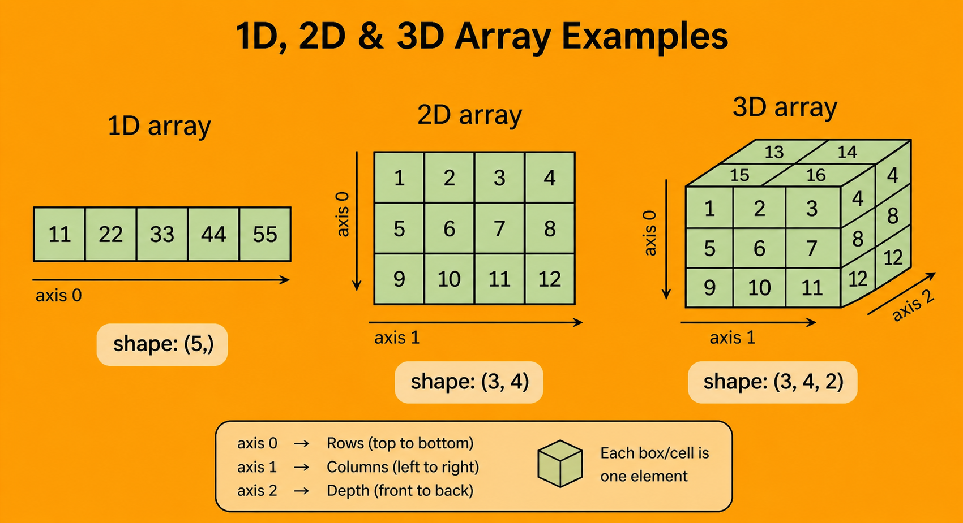

Slide 20
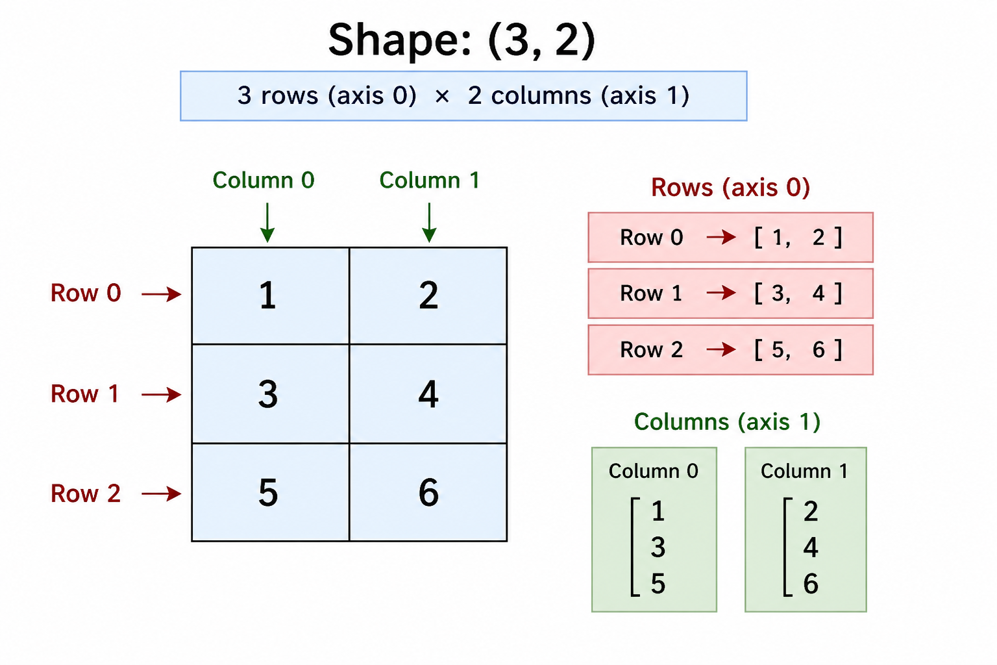

Slide 21
axis 0 पहले (Y), axis 1 बाद में (X)
Y-axis → Vertical (ऊपर-नीचे) → axis 0
X-axis → Horizontal (बाएँ-दाएँ) → axis 1
Array :(y,x) ---row -col
Graph :(x,y)

Slide 22
3D Array
(3, 4, 2)
3 → Rows (axis 0)
4 → Columns (axis 1)
2 → Depth / Layers (axis 2)
सामने वाली grid = 3 rows × 4 columns
पीछे एक और layer
कुल 2 layers
axis 0 ↓ ऊपर से नीचे (Rows)
axis 1 → बाएँ से दाएँ (Columns)
axis 2 ↗ आगे से पीछे (Depth)

Slide 23
Array Properties
arr = np.array([[1,2,3],[4,5,6]])
print(arr.ndim) # Dimension
print(arr.shape) # Rows, Columns
print(arr.size) # Total elements
print(arr.dtype) # Data type

Slide 24
Special Arrays
Zeros
np.zeros((2,3))
Ones
np.ones((3,3))
Identity Matrix
np.eye(3)
Range
np.arange(1,10,2)
Line Space
np.linspace(0,10,5)

Slide 25
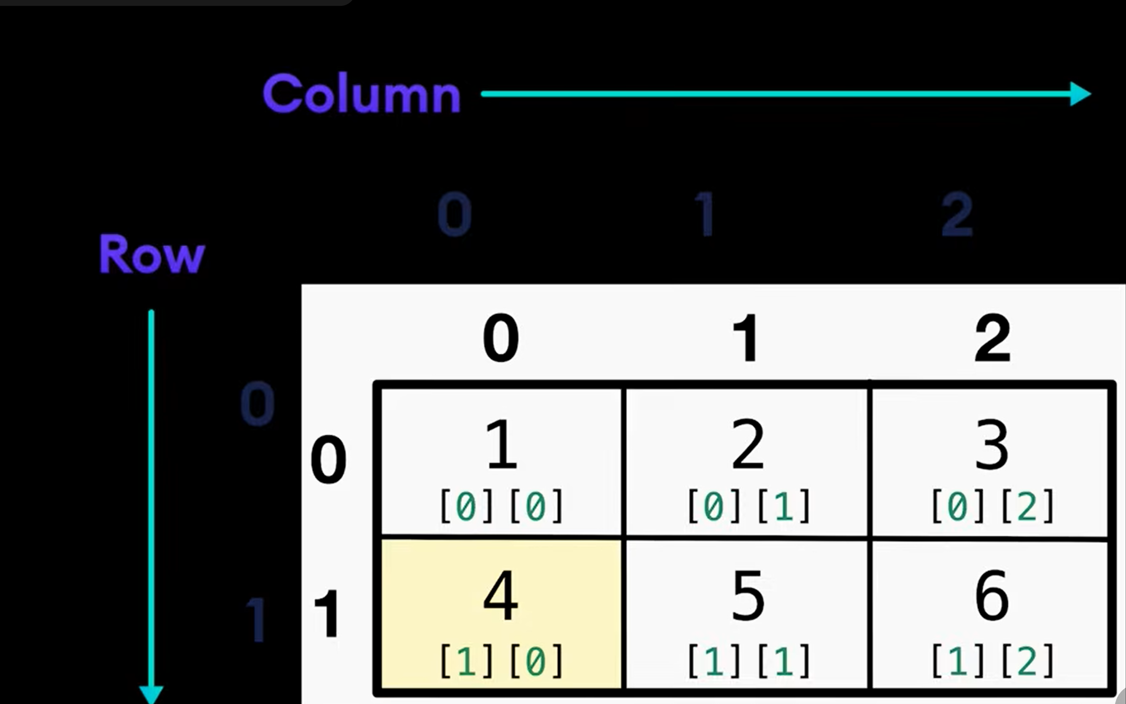

Slide 26
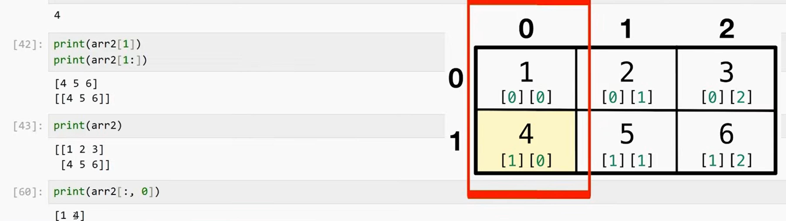

Slide 27
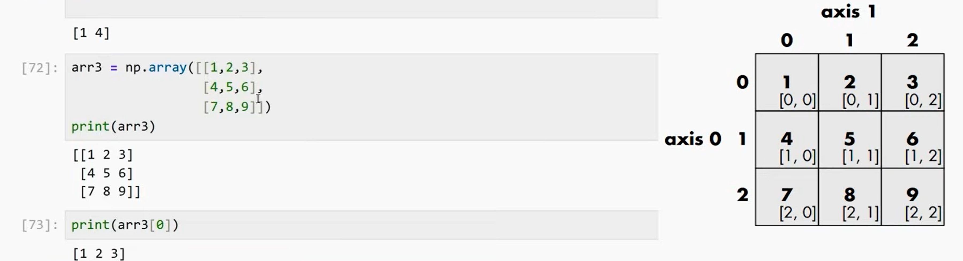

Slide 28
Pandas
Pandas Python ki powerful library hai jo:
Data Analysis
Data Cleaning
Data Manipulation
CSV/Excel Handling
Statistical Analysis
ke liye use hoti hai.

Slide 29
Pandas Introduction
Pandas Python ki ek popular open-source library hai jo data analysis aur data manipulation ke liye use hoti hai. Ye structured data (rows aur columns) ko handle karne mein help karti hai, bilkul Excel sheet ki tarah.
Pandas ka use large data ko read, clean, organize, analyze aur process karne ke liye hota hai

Slide 30
Why Pandas Important Hai?
CSV/Excel files read karna
Data clean karna
Missing values handle karna
Reports banana
Statistical analysis
Machine learning ke liye data prepare karna

Slide 31
Real Life Use:
Student records
Sales reports
Excel automation
Data science
Machine learning preprocessing

Slide 32
Pandas Install Karna
pip install pandas
import pandas as pd

Slide 33
Main Data Structures
1. Series
Single column data.
import pandas as pd
s = pd.Series([10,20,30,40])
print(s)

Slide 34
Statistics Kya Hai?
Statistics ek aisa subject hai jisme hum data ko
Collect karte hain
Organize karte hain
Analyze karte hain
Understand karte hain
taaki sahi decision le sakein.
Ye Data Analytics, AI, ML, Banking, Business, Medical sab jagah use hota hai.

Slide 35
Real Life Example
Maan lo ek class ke marks hain:

